Slide 1
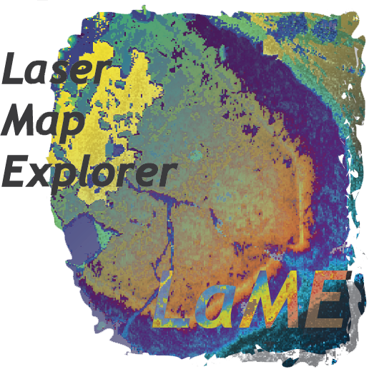

Laser Map Explorer (LaME)
Derrick Hasterok, Shavin Kaluthantri, Maggie Li, Stijn Glorie, Martin Hand, Alex De Vries Van Leeuwen

Slide 2
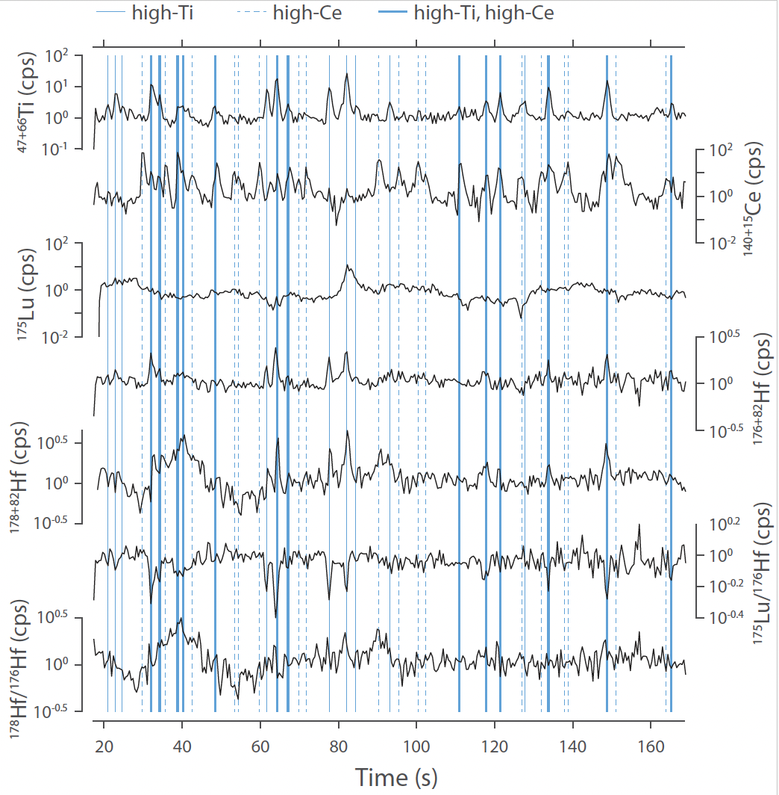
LaME Features
Import LA-ICP-MS data (and now XRF images)
Rapidly transform, view and analyze map-form data
Unsupervised machine learning (PCA, Clustering)
dimensional reduction
classification
Produce standard geochemical plots on selected map features
by class, region, or along profiles
Note taking (makes supplements a breeze)
Workflow design
customize and save analysis
batch process multiple samples

Slide 3

The interface
Written in Python, Javascript, Blockly
Source code available on GitHub
https://github.com/dhasterok/LaserMapExplorer
Executable version
MacOS
Windows

Slide 4
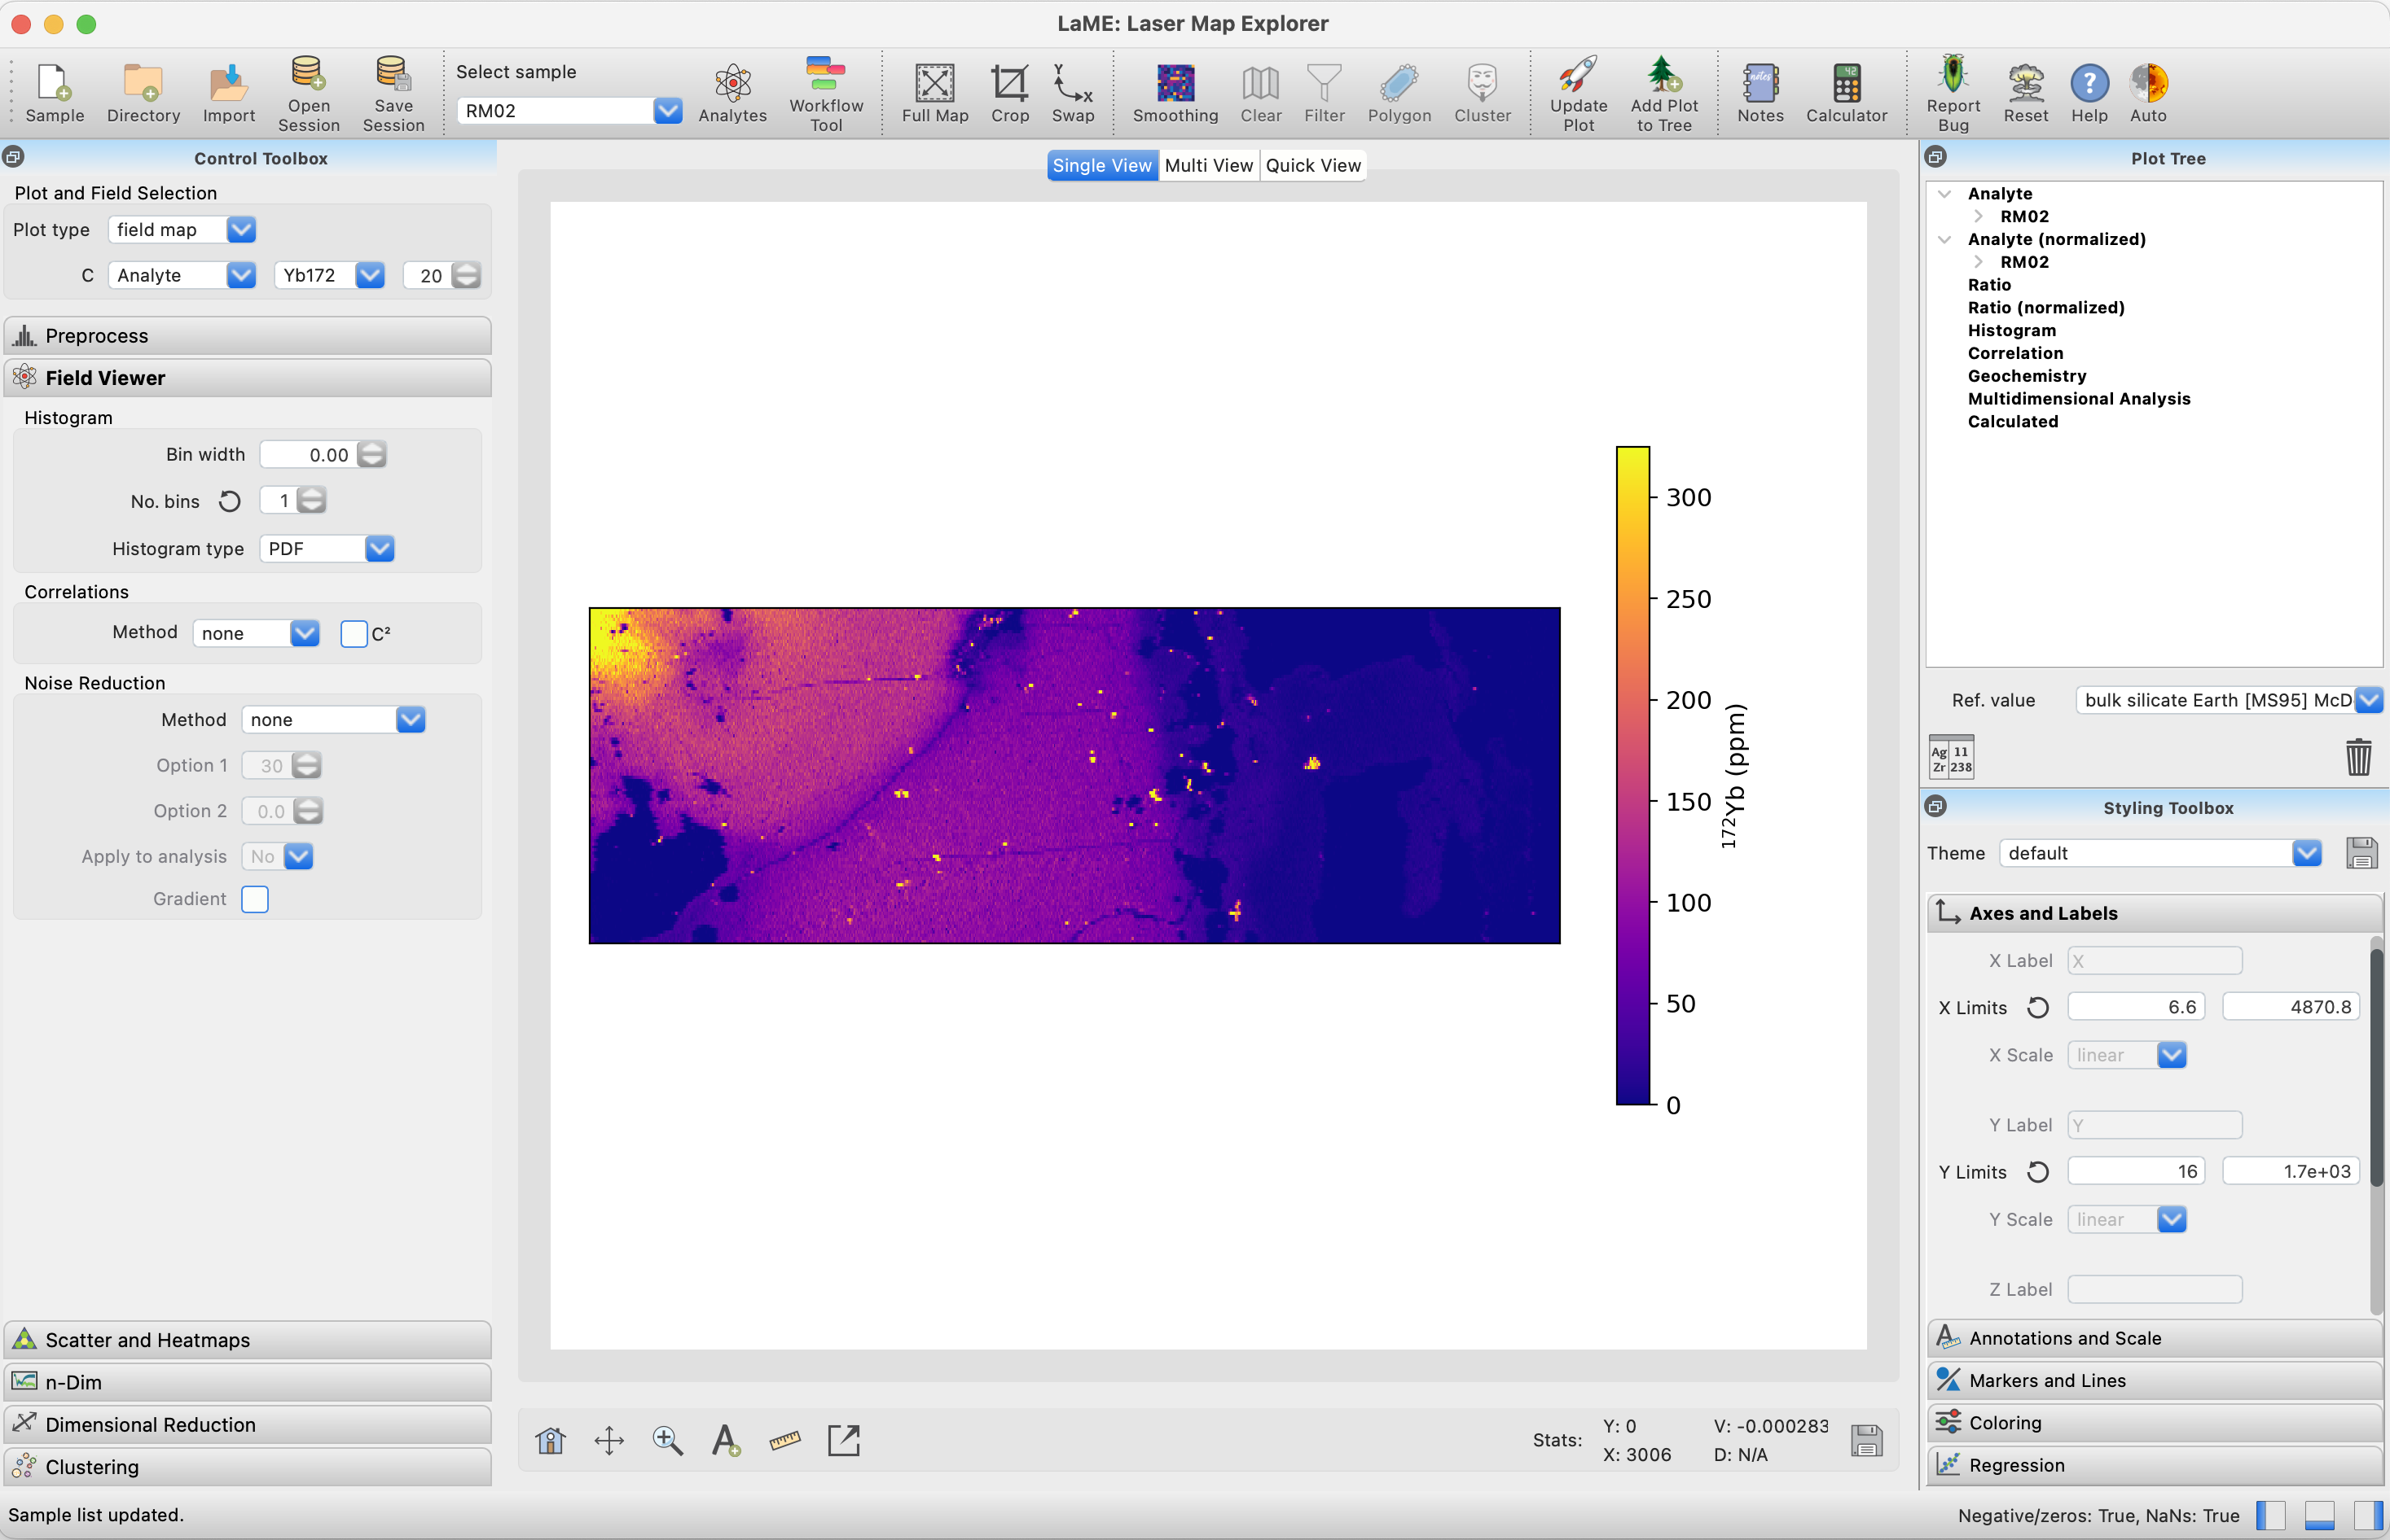
Canvas
Field/Plot Selector
Plot/Analysis Dock
Style Dock

Slide 5
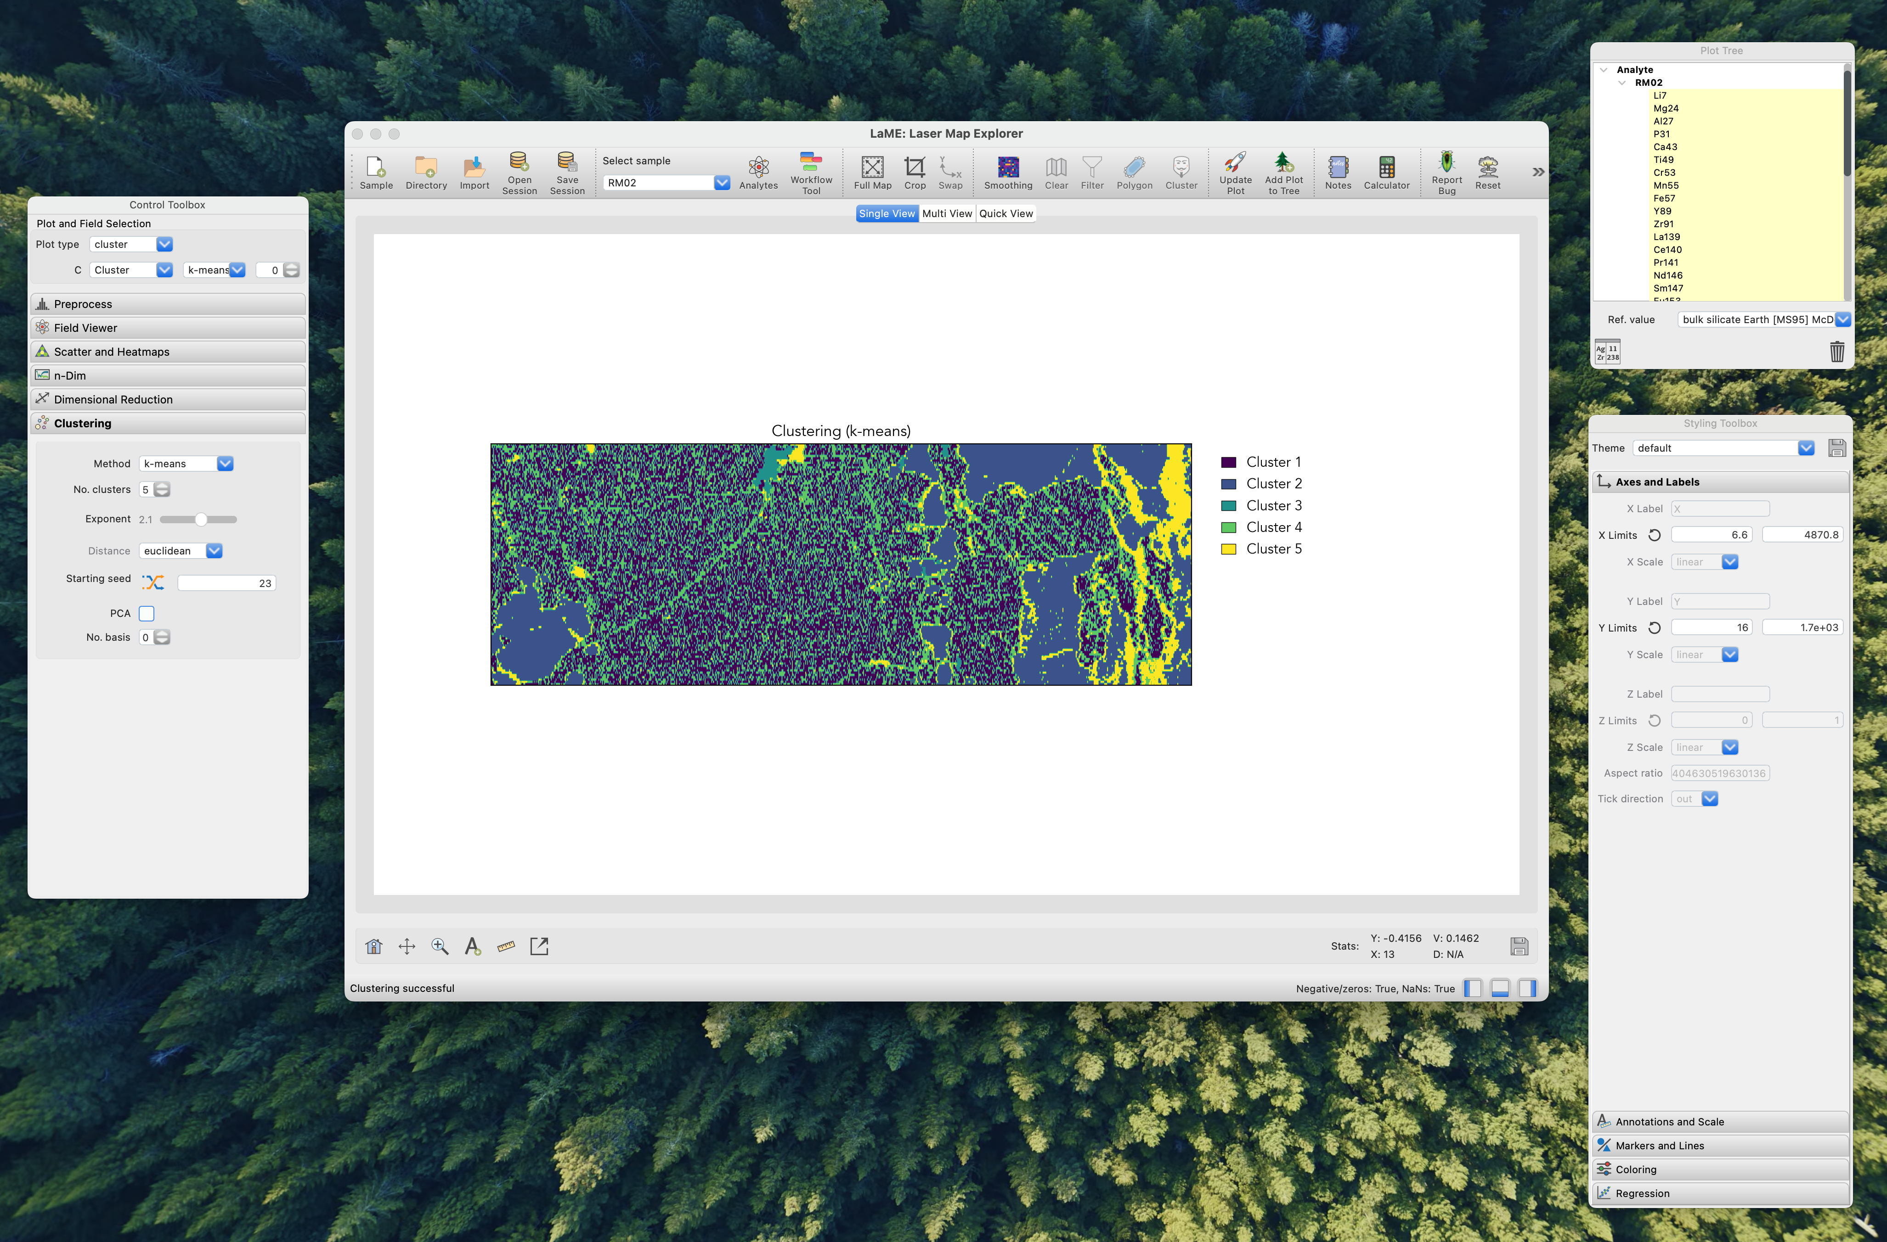

Slide 6
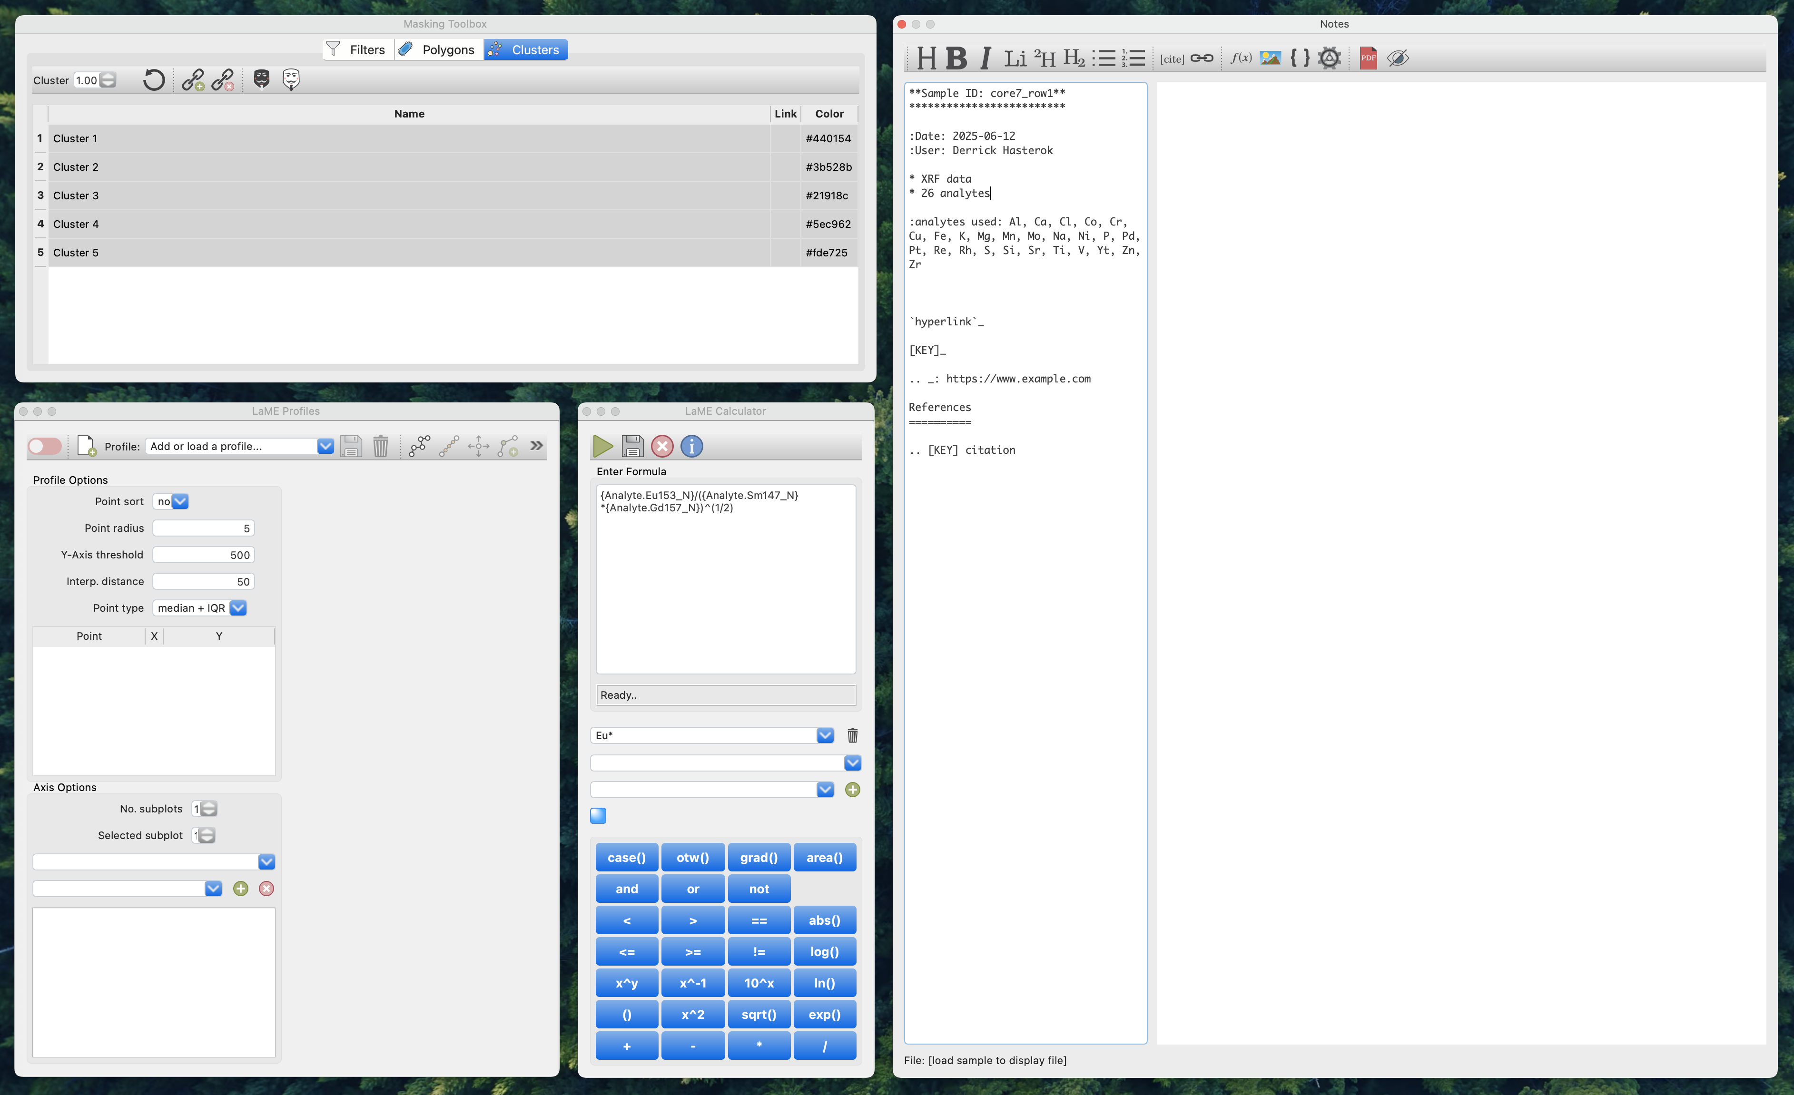
Filtering and Masking
Note Taking & PDF Creator
Custom Field
Calculator
Profile Tool

Slide 7
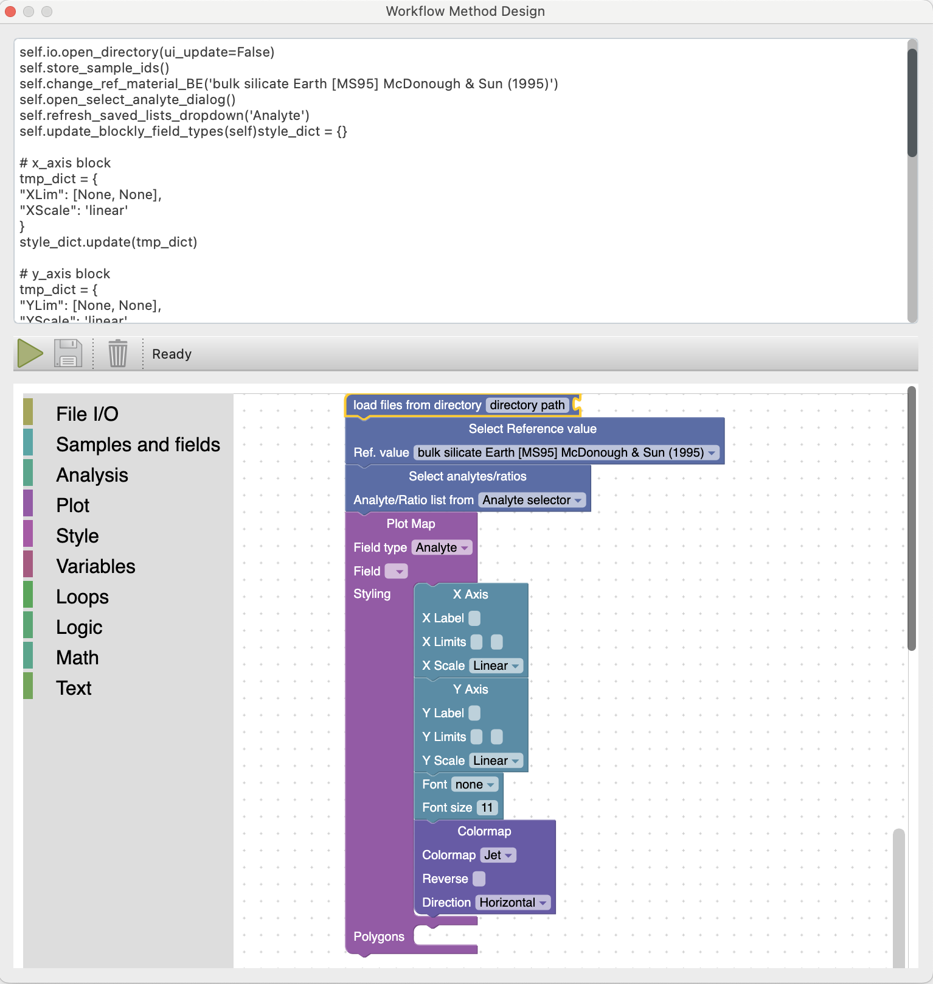

Workflow Design
Custom implementation of Google’s Blockly
Customize and save workflow
Analyze one or multiple samples
Produce and export plots
PNG, EPS
Automated document summaries (PDF)

Slide 8
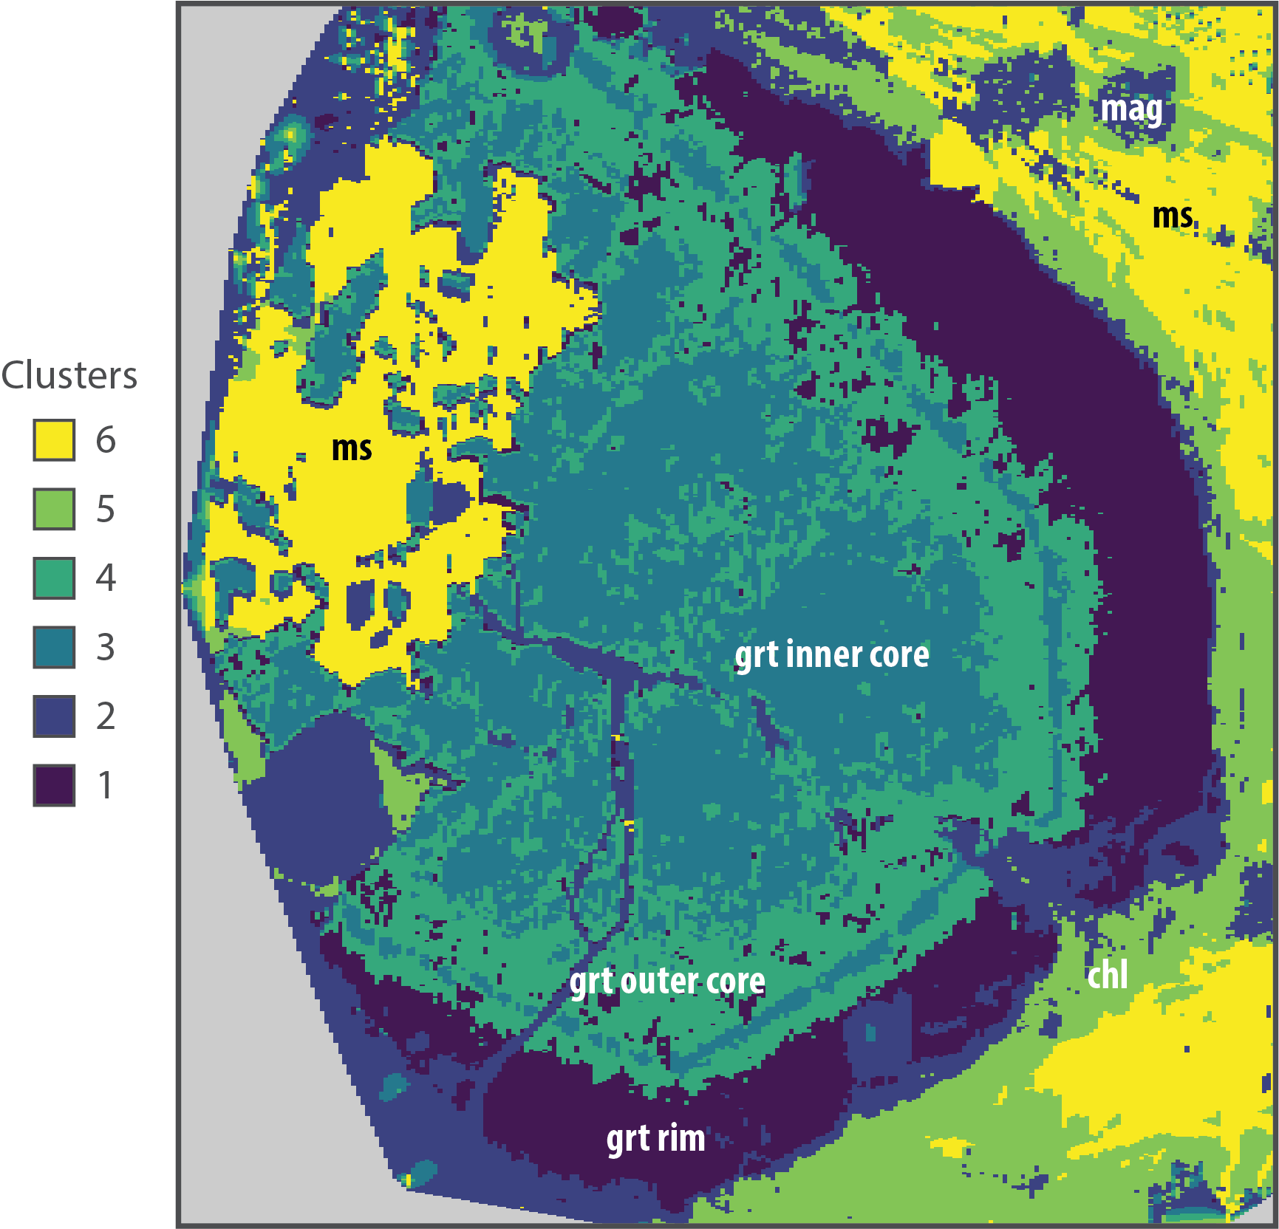
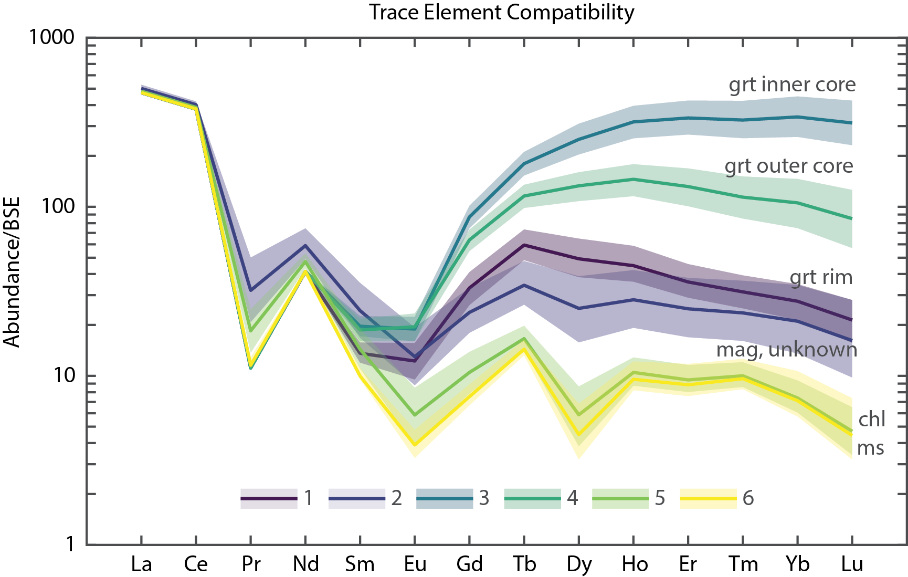
Chemical Classification

Slide 9
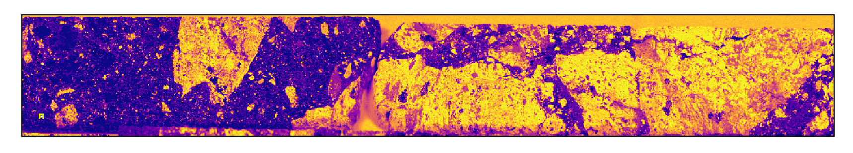
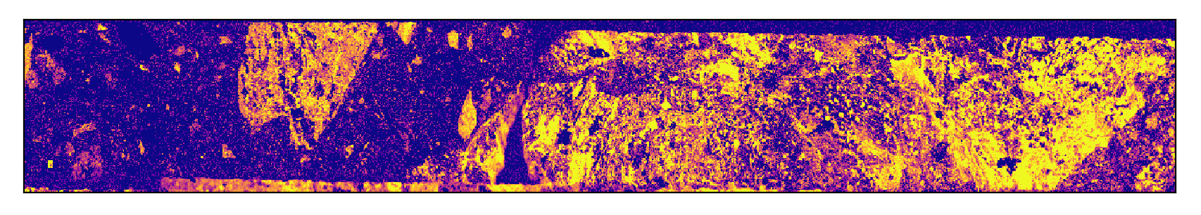
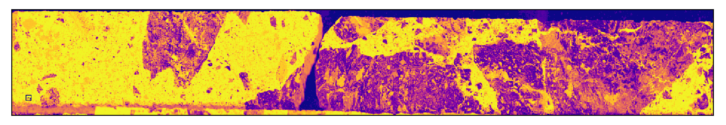
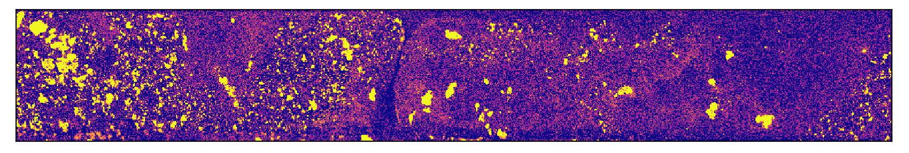
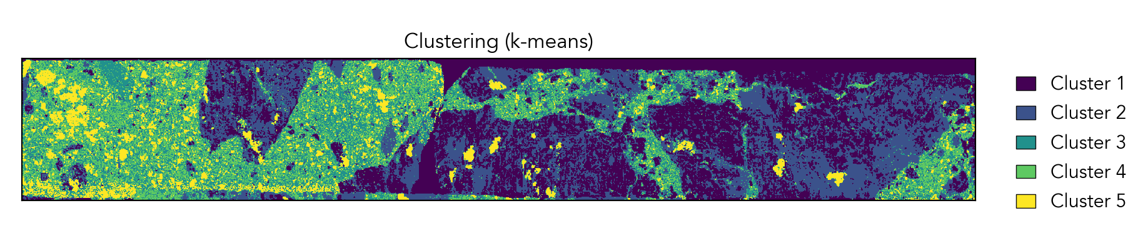
XRF data
Si
K, Al
Fe, Ca
S

Slide 10
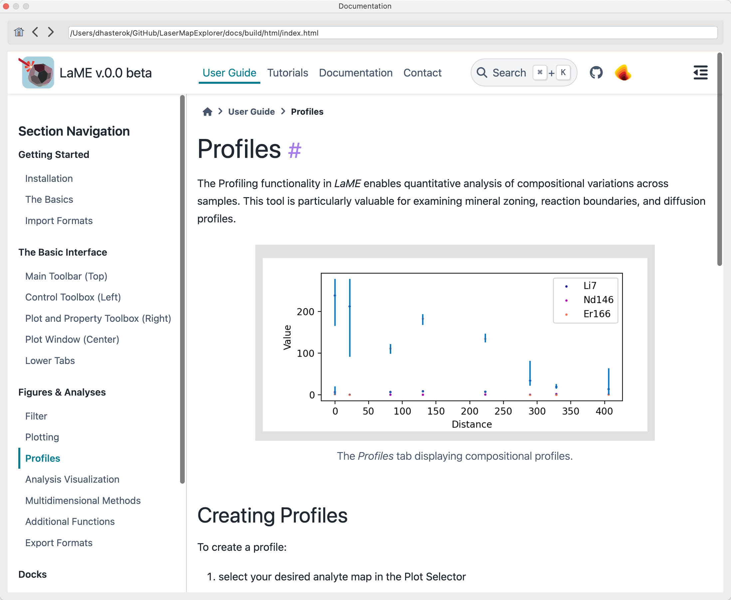
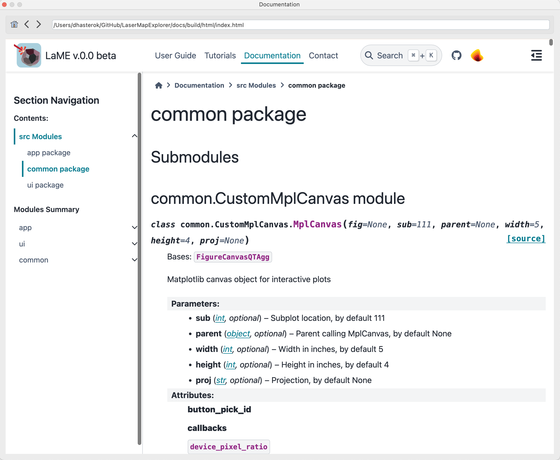
Integrated Web-based User Guide & Source Documentation

Slide 11


Accessing LaME
Current state
Timeline
stable version (mid-late August)
new features, ongoing
Access on GitHub
https://github.com/dhasterok/LaserMapExplorer

Slide 12

Future development
Continue to add new data types
Add raw processing (KJ, Peiter Vermeesch and Stijn Glorie)
Add dating (IsoplotR, P. Vermeesch)
Diffusion modeling
What would you like to see LaME do?

Slide 13
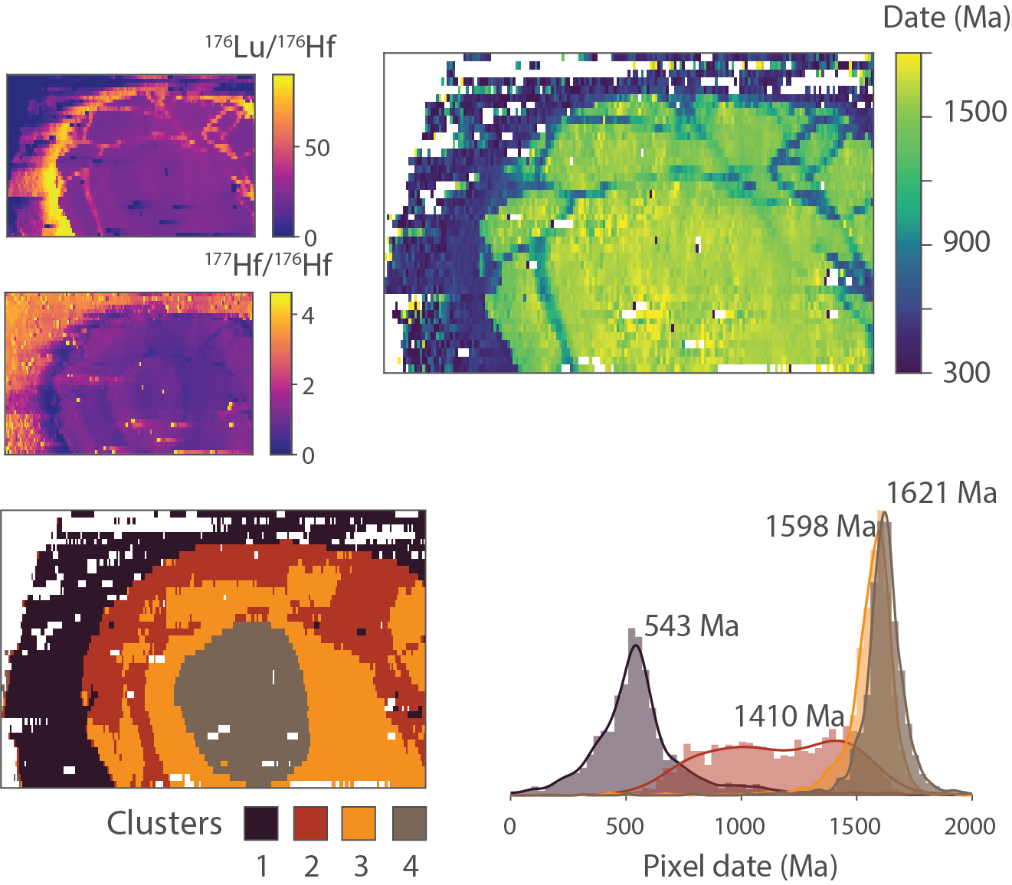
Dating
Re-Os
Lu-Hf (submit next week)
Rb-Sr (to do)
U-Pb (to do)

Slide 14
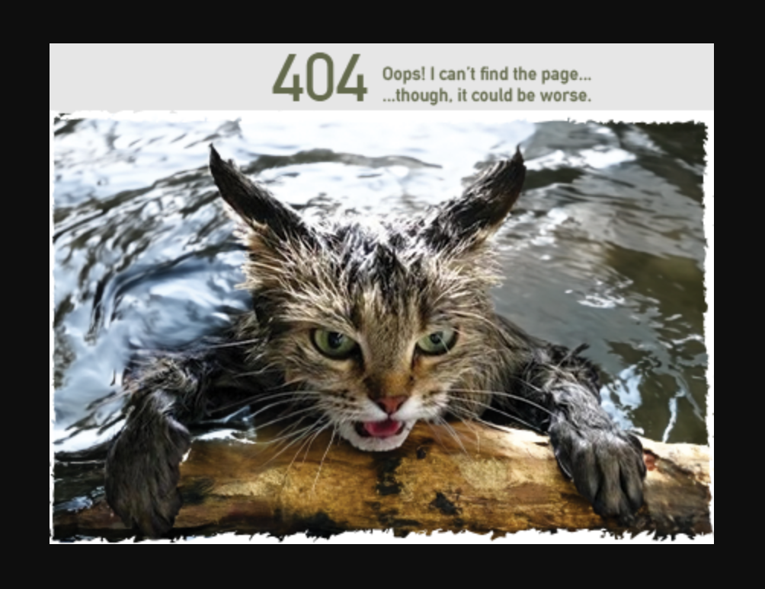
Questions

